Slide 1
Fitness Scholars
Team members: Charan Saragadam, Trinity Valera, Salim Aldakheel, Ken Kurian, Rohan Maisuria, Edsson Zapata

Slide 2

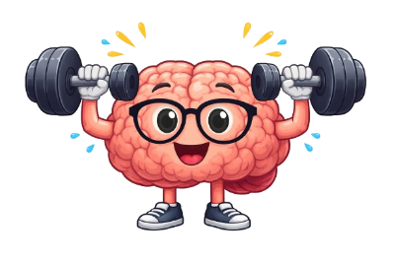
Team name, Motto, and Mascot
Team Name – Fitness Scholars
Motto - "Learning Smarter, Growing Stronger"
Mascot -

Slide 3
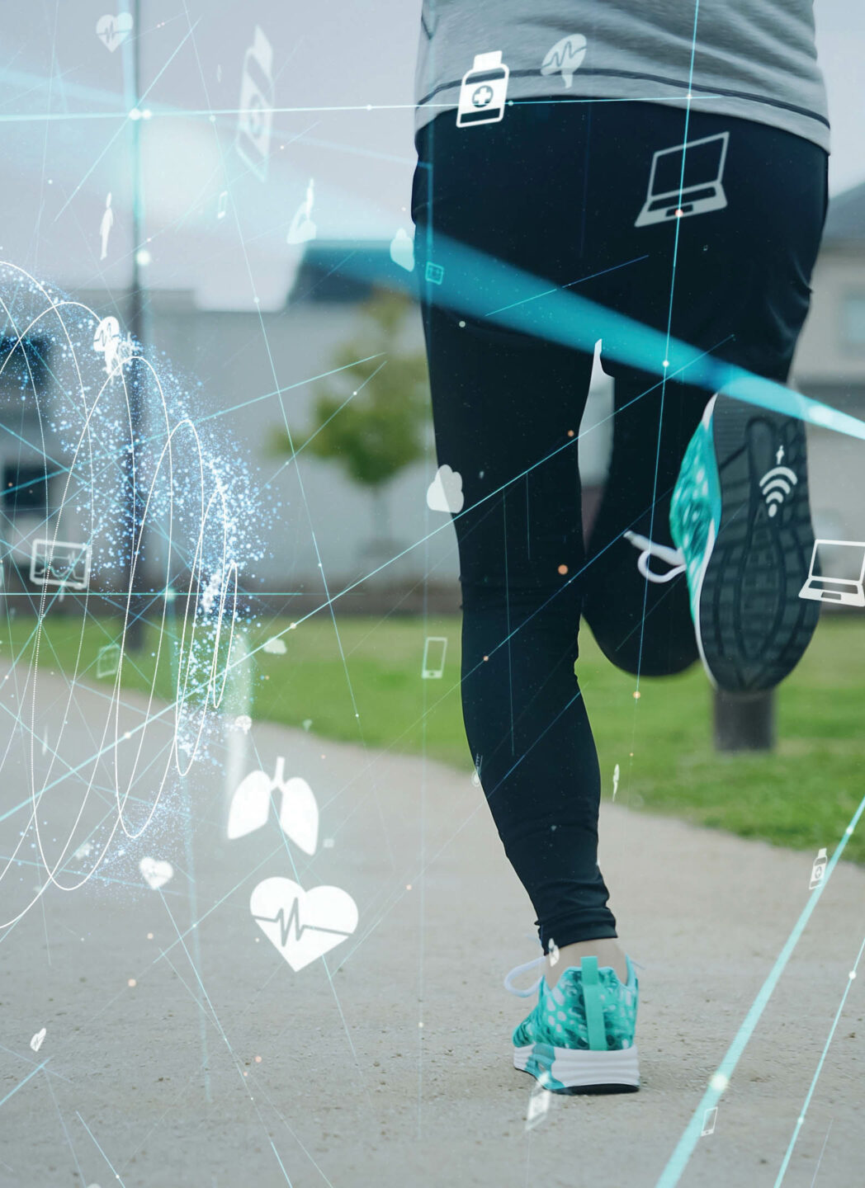
Our Vision
"To create a future where technology is leveraged to achieve fitness goals efficiently, promoting healthier habits that will enable every scholar to achieve both physical and mental well-being without compromising academic achievement."

Slide 4

The Mission/Purpose
Fitness Scholars mission is to create an AI-Based Health and Fitness app designed for a student's busy lifestyle by providing personalized workout routines, meal recommendations, and general wellness suggestions to better help students achieve their fitness goals while also achieving their academic goals. We in fitness scholars aim to build a strong team dynamic where helping one another with any difficulties is commonplace. We will strive to share and improve each other's ideas and further encourage creativity within the team.

Slide 5

Goals
Complete project milestones on time, measured by whether deadlines are met by everyone on the team over the course of the project.
Maintain consistent communication between the team using chat channels such as Discord and Zoom chats. Measured by how consistent each member is participating in team collaboration chats
Improve teamwork within the team by having team member check-ins and offering feedback to each member of the team to increase the team flow. This can also be measured by how many of the blockers/challenges involve poor team communication
Increased creativity by encouraging new ideas and perspectives, this can be measure through the ideas that are presented in the meeting and the notes from brainstorming sessions. Each member should try and present at least one idea or solution during meetings
Encourage outside perspective through feedback from peers, measured by trials and tests done when the product/demo is complete. Get 5 outside perspectives on the app from its desired demographic.

Slide 6
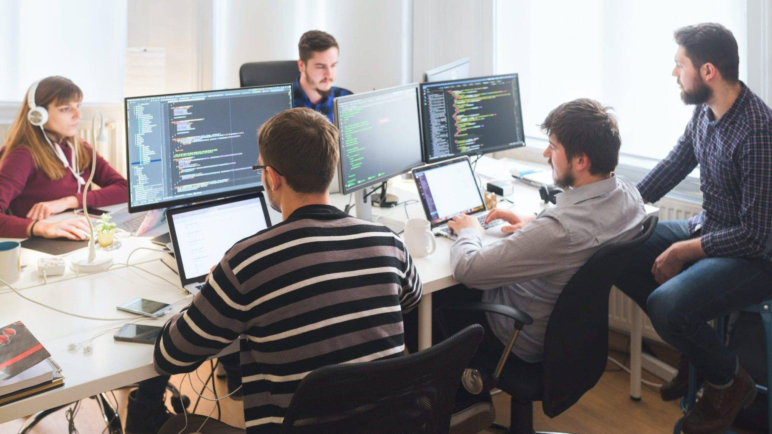
Roles
Role Name | Responsibilities | Team Member Assigned
Coordinator | Prepares meeting agenda in advance, organizes discussion topics, task assignments, and ideas. | Trinity
Timekeeper/Scribe | Records the results of meetings and tracks the time allocated to meeting agendas, helps to ensure meetings stay on schedule. | Ken
Research Manager | Conducts and keeps track of background research. Gathers information and summarizes for use in design and development decisions. | Salim
Design Manager | Keeps track of design ideas and structures to keep records of design concepts and possible revisions. | Charan
Presentation Manager | Creates presentations for class and helps keep the team informed and practiced on presentations. | Trinity, Rohan, Ken
Quality Assurance | Tests functionality of the app identifies bugs and provides verification ensuring usability requirements are met. | Edsson
Database Coordinator | Manages and handles data storage and coordinates database integration within the application. | Rohan
Fitness/Content Specialist | Provides and researches knowledge on fitness and health. Ensuring content accuracy and assisting with features related to such. | Trinity, Ken, Charan, Salim
Team Facilitator | Manages team and tracks deadlines. | Trinity
Lead Developer (Front/Back End) | Implements application functionality. Takes lead on coding contributions and ensures technical consistency of the application. | Edsson (Back end), Trinity (Front end)
AI/ML specialist | Research and integrates AI/ML functionality. Assists with model selection and logic. | All Team Members

Slide 7

Ground Rules
The following ground rules will outline how the team intends to work together throughout the entire project. These rules establish our shared expectations for organization, task completion, communication, and most importantly teamwork. By clearly defining how each decision will be made, how responsibilities are handled, and how each team member interacts with each other. The team will aim to promote accountability, efficiency, and a respectful collaborative environment that supports the accomplishment of our project.

Slide 8

Administrative
The Fitness Scholars team will meet in person every Tuesday after class to review goals, discuss progress, and assign tasks. The Timekeeper/Scribe will record attendance, key points, and deadlines, and share a summary if anyone is absent.
Additional meetings may be held on Sundays at 2:00 PM via Zoom or in person on campus if needed. Meeting details will be shared ahead of time.
Project progress will be tracked through weekly team reports that list completed tasks, ongoing work, and challenges. If the team falls behind, workloads will be adjusted and a plan will be created to stay on track.
All team communication and shared documents will be managed through tools like Discord, Google Docs, and Zoom to keep everything organized and clear.

Slide 9

Task
Our team goal will be to use consensus voting when making decisions but will resort to majority rule if there is any divide to encourage fairness. Ties will be addressed using a coin toss.
All discussions will be professional, respectful, and with end goal in mind. Disagreements will be addressed by the Team
Each member of the team should take responsibility for their roles and responsibilities and should maintain engagement throughout the project. Team members will participate in every meeting, contributing to the overall success of the project.
Most problem-solving will be addressed as a group to encourage participation and allow solutions to be presented. This ensures that the different backgrounds of each team member is utilized during troubleshooting and problem solving.

Slide 10

Interpersonal
Team members will listen carefully to each other and communicate openly without fear of judgment. We will respect one another and value everyone’s ideas and perspectives. When difficulties come up, we will support and help each other, remembering that we are a team and succeed by working together.

Slide 11
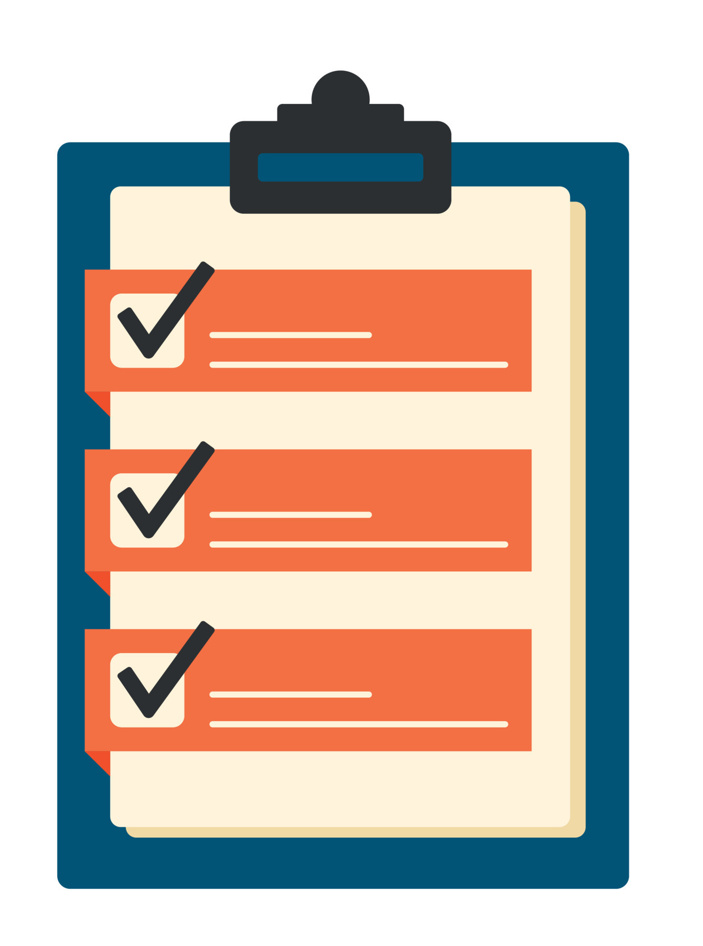
Procedures: How We Track Team Effectiveness
Our Data Sources
Meeting Notes
Record attendance, agenda items, and decisions made
Interpersonal and administrative rules check
Weekly Team Reports
Summaries of completed work, blockers, and communication challenges
Interpersonal and task rules check
Project Management Document
Tracks task assignments, deadlines, and progress
Administrative and task rules check

Slide 12

Plans and Tools for Gathering Team Self-Assessment Data
Team self-assessment will be used to evaluate teamwork, communication, and overall performance throughout the project. Information will be collected through:
meeting notes
weekly reports
shared progress document that tracks tasks and project milestones.
The team will also hold informal peer feedback check-ins to discuss workload balance and team dynamics. Feedback from users and peers during testing will be reviewed to help improve collaboration and the final product.

